Slide 1
Large-Case Term Solutions
Competitive premiums for temporary convertible coverage

Slide 2
Lincoln Financial
Financial strength
Capacity
Under- writing
Product & pricing
Notes:
So today we're going to talk about the four reasons why you should consider Lincoln for your next large term case. First we'll start off with Lincoln's <CLICK>financial strength. Next our <CLICK>capacity and the <CLICK>underwriting available. And finally the <CLICK>Lincoln LifeElements Level Term the product and the competitive pricing with it.

Slide 3
Lincoln National Corporation Quarter ending June 30, 2017
2014 Fortune 500 list | #232 | by revenue
 | #26 | by assets
2014 Barron’s 400 list | #214 | Based on the most revenue growth and cash returns¹
Assets under management | $241 billion
Total adjusted statutory capital | $9 billion²
Invested cash | $523 million³ | At the holding company
2017 Fortune 500 list | #207 | by revenue
 | #24 | by assets
2016 Barron’s 500 list | #337 | Based on the most revenue growth and cash returns¹
1 Based on median three-year cash flow return on investment (ROI), 2016 sales growth, and adjusted for divestitures.
2 Represents statutory results of Lincoln National Life Insurance Company, Lincoln Life & Annuity of New York, and First Penn-Pacific Life Insurance Company. Results are estimated.
3 Available liquidity consists of cash and invested cash, excluding cash held as collateral, and certain short-term investments that can be readily converted into cash, net of commercial paper outstanding.
Notes:
So when you think of Lincoln Financial and the concierge's level of service provided by our wholesalers and maybe many of those relationships you've built with other teams like our competitive services group or advance sales team it might feel like a small company but consider the fact that <CLICK>Fortune 500 ranked Lincoln number 24 with <CLICK>241 billion dollars of assets under management. And that's kind of a big deal right number 24 out of 500 companies. That's something to brag about there.

Slide 4
Financial Strength Ratings through August 2, 2017
 | The Lincoln National Life Insurance Company | Lincoln Life & Annuity Company of New York
A.M. Best | A+ (2nd highest of 16) | A+ (2nd highest of 16)
Standard & Poor’s | AA− (4th highest of 21) | AA− (4th highest of 21)
Moody’s | A1 (5th highest of 21) | A1 (5th highest of 21)
Fitch A+ | A+ (5th highest of 19) | A+ (5th highest of 19)
These ratings apply only to the claims-paying ability as of August 2, 2017. All ratings are subject to revision or withdrawal at any time by the rating agencies. The ratings are not recommendations to buy, sell or hold our securities. For more information on ratings, including rating agency outlooks, see LincolnFinancial.com/investor.
Notes:
And as you would expect Lincoln Financial is well-regarded by the rating agencies.

Slide 5
Capacity for large term cases
Internal retention | Autobind¹ | Jumbo
$10M | $60M | $65M
$20M for permanent | Up to age 75 | Up to age 80
 | $50M ages 76-80 | $50M ages 81-85
 | $25M ages 81-85
Internal retention | Autobind¹
$10M | $60M
$20M for permanent | Up to age 75
 | $50M ages 76-80
 | $25M ages 81-85
Internal retention
$10M
up to $20M for permanent
up to
Super pool $150M
1 Autobind limits will be reduced based on rating and whether a client is a professional athlete or other high-pro le individual.
Notes:
So let's talk about Lincoln's capacity for a large term cases.
Let's talk about Lincoln's internal retention. It's up to <CLICK>10 million for term and $20 million for permanent. We do offer <CLICK>$60 billion autobind capacity up to age 75 anti-body. And as you heard from John Devecchis from the office of the chief underwriter on Monday our underwriters do have the ability to write, on their own signature, 90 plus percent of the cases that we underwrite. Lincoln also has jumbo capacity up to <CLICK>65 million up to age 80. And don't forget <CLICK>$150 million super pool as well

Slide 6
Underwriting
LincXpress® Tele-App
Help reduce NIGO to ZERO
Concierge service
Associate Chief Underwriters
Exclusive New Business point-of-contact
Favorable tobacco ratings
Non-cigarette tobacco users can qualify for nontobacco rates
Notes:
In addition to the strong capacity we offer <CLICK>LincXpress Tele-App which is an app capture process that can help reduce the not in good order to zero
<CLICK>concierge service through our Associate Chief underwriters as well as an exclusive new business point of contact.
And don't forget about the <CLICK>favorable tobacco ratings Lincoln offers as well for any smokers of pipes and cigars and also any chewers of tobacco they qualify for non-tobacco rates.

Slide 7
Lincoln LifeELements® Level Term (2017)
10, 15, 20, and 30 year durations
Convertible to permanent coverage Level term duration up to age 70
Design flexibility Face reductions allowed years 4+
Competitive pricing Most competitive ages 45 and older with face amounts $500K and greater
Notes:
None of these benefits would mean anything if we didn't offer a compelling product though
Lincoln LifeElements Level Term is available in <CLICK>10 15 20 and 30 year durations.
It is <CLICK>convertible to permanent coverage for the entire duration of a level term period up to age 70
The product offers <CLICK>design flexibility through optional face reductions any time after the third policy year. And the product is <CLICK> priced for key competiveness at ages 45 and older with face amounts of half a million and greater.

Slide 8
Convertible without evidence of insurability
policy years 1-7
policy years 8+
Full product portfolio
Limited portfolio
Includes any single universal life and variable universal life policies available for new sales at the time of conversion except policies:
Includes at least one single-life individual permanent life insurance policy made available for the purpose of conversion at the time of conversion.
Without surrender charges or with riders and/or benefits that waive surrender charges or enhance surrender value
Sold within the Guaranteed Issue or Simplified Issue underwriting classification
That include riders and/or benefits that provide optional long-term care coverage
Please refer to Lincoln’s Term Conversion Guidelines for details on current term conversion commissions
Notes:
So convertibility can be a significant concern for policy owners and agents, policies are eligible for fully compensated conversions at any point during a level period up to age 70.
For the first <CLICK>seven years the policy can be converted to the full product portfolio. And while that policy can be converted after the seventh year it is converted to a <CLICK>limited product portfolio.
<CLICK>Please refer to Lincoln’s Term Conversion Guidelines for details on current term conversion commissions

Slide 9
Death Benefit Flexibility
Has a 20-year $10M loan to expand her business into new markets and modernize equipment
Wants minimum cost and maximum flexibility
Janine
45 years old
Notes:
So now let's talk about an important feature in the life element's level term the death benefit flexibility and examine it in a case study.
So let's meet <CLICK>Janine. She's a 45 year old business owner who just took out a <CLICK>20 year $10 billion loan to expand her business into new markets. She wants a solution that will <CLICK>minimize her costs but maximize her flexibility

Slide 10
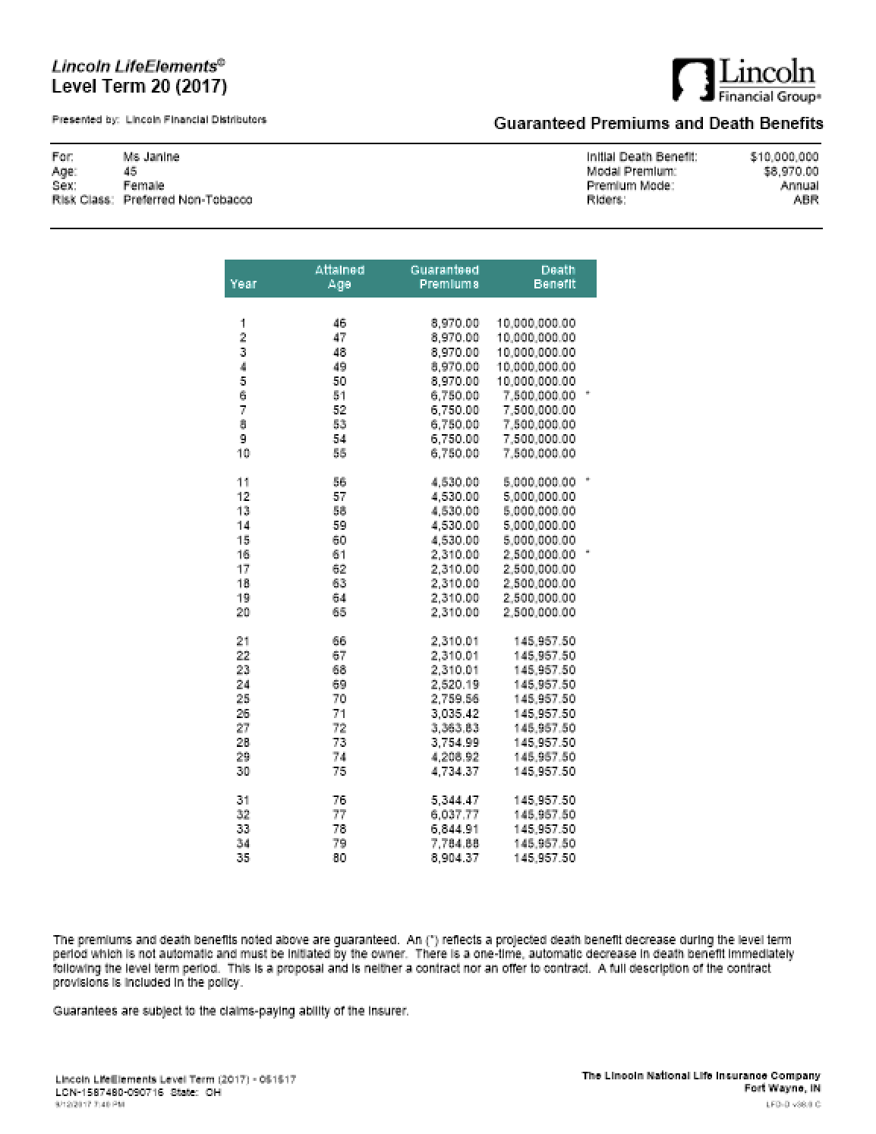
Death Benefit Flexibility
45 year-old female
Preferred non-tobacco
Lincoln LifeElements® Level Term 20 (2017)
$10M initial face amount
Reduced to $2.5M by the end of the term period
Notes:
So we proposed the Lincoln life element's level term with a decreasing $10M death benefit.

Slide 11
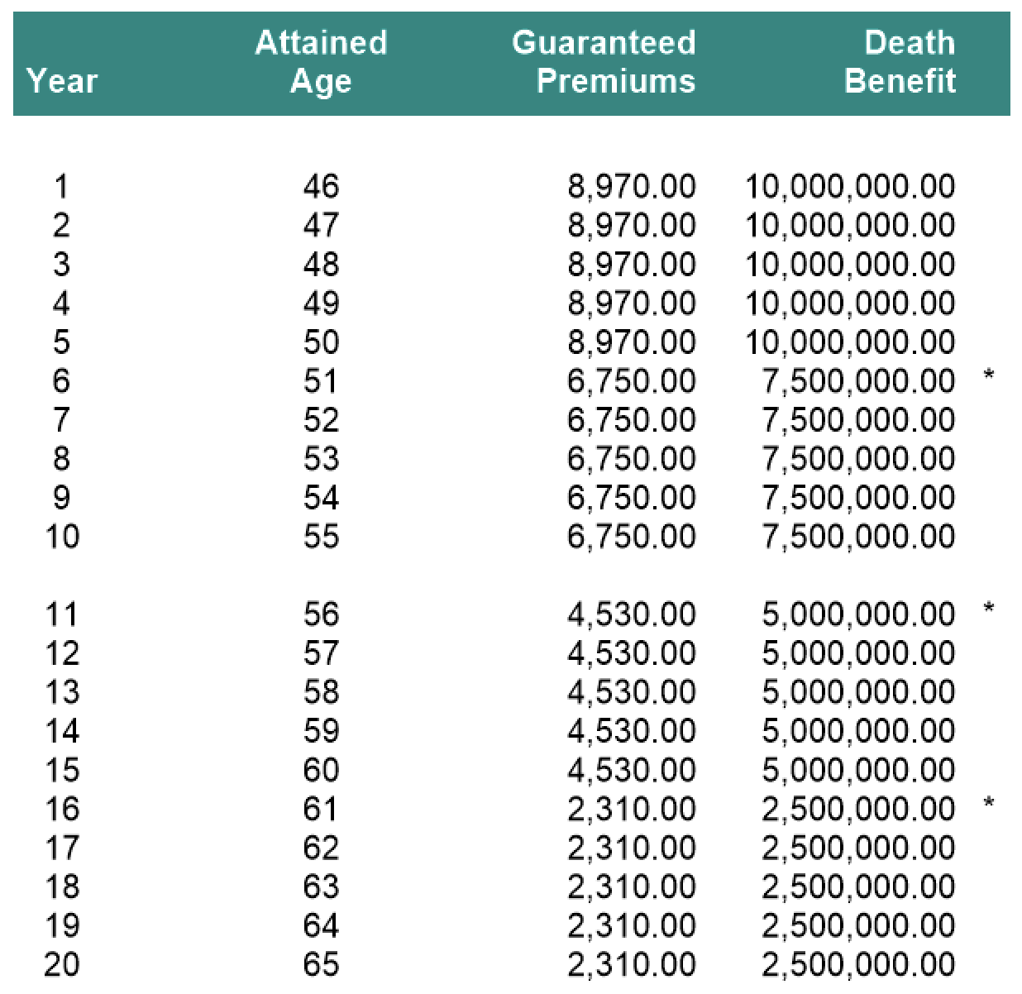
Death Benefit Flexibility
45 year-old female
Preferred non-tobacco
Lincoln LifeElements® Level Term 20 (2017)
$10M initial face amount
Reduced to $2.5M by the end of the term period
Notes:
So here's the proposal for Janine.
Notice the <CLICK>$10M death benefit in the first five years <CLICK>dropping by two and a half million every <CLICK>five years on we get it down to <CLICK>two and a half million by the last five years.
And if we look at the <CLICK>guaranteed premiums the solve is calculated every five years.
So you start with 8,970 and dropped down to 6,750 and so on till you're at 23 10 years 16 through 20 for two and a half million of face.
So she did want to maximize her flexibility though. So while we are showing a reducing death benefit every five years she can either keep that $10 million death benefit she will just have to pay that 8917 premium or she can even lower that death. And for every year starting from Year 4 on we just discussed our financial strength our capacity and our underwriting and discussed the product flexibility.

Slide 12
Important Disclosure. Please read.
The competitor information in the following slides is from public sources deemed reliable from peer group companies. Although every attempt has been made to ensure the accuracy of the information provided, it cannot be guaranteed. Product features and benefits, expenses, loads and charges will vary from company to company and will impact the values shown. The product’s specific features and the client’s use of those features will impact long-term policy performance.
This information is provided to help producers evaluate Lincoln’s products in relation to competitors’ products. This comparison is not intended for and cannot be used with the public. Information is from public sources deemed reliable from peer group companies. Although every attempt has been made to ensure accuracy, it cannot be guaranteed. This information does not include product details. Each product’s features and benefits should be weighed against the cost.
Information current as of September 1, 2017, and must be rechecked after March 1, 2018.
Notes:
<MAY HIDE SLIDE DEPENDING ON AUDIENCE UNLESS LADDERS ARE SHOWN>
Let's really get into it and talk about the pricing of life elements turn.

Slide 13
Important Disclosure. Please read.
The following ladders compare the premium requirements for the following term products:
American General Select-a-Term
AXA BrightLife Term
Banner OPTerm
John Hancock Term 17
Lincoln LifeElement® Level Term (2017)
Mutual of Omaha Term Life Answers
Nationwide Guaranteed Level Term
North American ADDvantage Term
Pacific Life Prime Term
Penn Mutual Guaranteed Term
Principal TermProtective Classic Choice Term
Protective Custom Choice UL
Prudential Term Elite
Prudential Term Essential
Transamerica Trendsetter Super
Notes:
<MAY HIDE SLIDE DEPENDING ON AUDIENCE UNLESS LADDERS ARE SHOWN>
Here are the competitors that we see in the term space.

Slide 14
$20M death benefit for 45 Male, Preferred Best
 | 20-year term
Lincoln LifeElements® Level Term | $20,070
John Hancock Term 17 | $20,200
American General Select-a-Term | $20,264
Nationwide Guaranteed Level Term | $20,275
Principal Term | $20,295
Banner OPTerm | $20,339
Protective Classic Choice Term | $20,455
AXA BrightLife Term | $20,875
Prudential Term Essential | $21,085
North American ADDvantage Term | $21,265
Pacific Life Prime Term | $21,465
Penn Mutual Guaranteed Term | $21,670
Protective Custom Choice UL | $21,726
Mutual of Omaha Term Life Answers | $22,063
Prudential Term Elite | $23,485
Transamerica Trendsetter Super | $29,030
 | 20-year term | 30-year term
Lincoln LifeElements® Level Term | $20,070 | $36,070
John Hancock Term 17 | $20,200
American General Select-a-Term | $20,264 | $35,864
Nationwide Guaranteed Level Term | $20,275 | $39,075
Principal Term | $20,295 | $36,475
Banner OPTerm | $20,339 | $34,560
Protective Classic Choice Term | $20,455 | $37,855
AXA BrightLife Term | $20,875
Prudential Term Essential | $21,085 | $37,485
North American ADDvantage Term | $21,265 | $36,665
Pacific Life Prime Term | $21,465 | $38,265
Penn Mutual Guaranteed Term | $21,670
Protective Custom Choice UL | $21,726 | $39,684
Mutual of Omaha Term Life Answers | $22,063 | $39,663
Prudential Term Elite | $23,485 | $40,685
Transamerica Trendsetter Super | $29,030 | $51,030
Sorted by lowest 20-year term premium
Notes:
<MAY HIDE SLIDE DEPENDING ON AUDIENCE>
Let's start by looking at a 20 million dollar death benefit for 45 male preferred best category. <CLICK>Here Lincoln is number one.
Now if the insured was looking for longer coverage duration we can look at that <CLICK>30 year term where Lincoln falls within the top three. You may notice some gaps in the ladder here and that's because these carriers don't offer a 30 year term at this age and face amount.

Slide 15
$20M death benefit for 65 female, Preferred NT
 | 20-year term
Protective Classic Choice Term | $138,455
Lincoln LifeElements® Level Term | $139,230
North American ADDvantage Term | $140,065
Protective Custom Choice UL | $140,945
Principal Term | $143,475
Penn Mutual Guaranteed Term | $147,070
American General Select-a-Term | $149,064
AXA BrightLife Term | $149,075
Prudential Term Essential | $154,885
Pacific Life Prime Term | $165,265
Mutual of Omaha Term Life Answers | $168,863
Banner OPTerm | $168,910
Prudential Term Elite | $172,285
Nationwide Guaranteed Level Term | $173,875
John Hancock Term 17 | $181,500
Transamerica Trendsetter Super | $203,030
<1% difference in premium
What do you “get” for $775 a year with Lincoln?
Financial strength
Capacity
Underwriting
Convertibility and flexibility
Sorted by lowest 20-year term premium
Notes:
<MAY HIDE SLIDE DEPENDING ON AUDIENCE>
Now let's look at a 65 year old preferred female with 20 million of coverage also looking for a 20 year term. <CLICK>Lincoln is number two on this ladder. The difference in premium is <CLICK>less than 1 percent. So <CLICK>what does the owner get for $775 year. Well as discussed Lincoln's <CLICK>financial strength the capacity to take on these cases the underwriting advantages and the flexibility and convert ability in these in the life elements product.

Slide 16
$5M death benefit for 55 female, Standard NT
 | 20-year term
Banner OPTerm | $26,235
Protective Classic Choice Term | $26,255
Lincoln LifeElements® Level Term | $26,395
American General Select-a-Term | $26,414
Protective Custom Choice UL | $26,761
Principal Term | $26,765
AXA BrightLife Term | $27,275
North American ADDvantage Term | $27,415
Penn Mutuakl Guaranteed Term | $28,420
Transamerica Trendsetter Super | $28,530
Nationwide Guaranteed Level Term | $30,025
Prudential Term Essential | $30,135
Mutual of Omaha Term Life Answers | $30,213
Pacific Life Prime Term | $32,165
Prudential Term Elite | $32,585
John Hancock Term 17 | $33,200
<1% difference in premium
Sorted by lowest 20-year term premium
Notes:
<MAY HIDE SLIDE DEPENDING ON AUDIENCE>
Now looking at a 65 year old preferred female for 5 million of coverage for 20 years you'll notice Lincoln is number three in the category. The question is why consider linking here when you're paying about 1 percent more in premium Lincoln's financial strength the capacity to take on these cases. The underwriting programs like Link Express and the product itself

Slide 17
$5M death benefit for 55 female, Standard NT
 | 20-year term | 30-year term
Lincoln LifeElements® Level Term | $26,395 | $45,000
American General Select-a-Term | $26,414 | $45,064
Banner OPTerm | $26,235 | $45,080
Principal Term | $26,765 | $45,175
Prudential Term Essential | $30,135 | $45,335
North American ADDvantage Term | $27,415 | $45,415
Transamerica Trendsetter Super | $28,530 | $49,480
Mutual of Omaha Term Life Answers | $30,213 | $50,063
Protective Custom Choice UL | $26,761 | $50,382
Protective Classic Choice Term | $26,255
AXA BrightLife Term | $27,275
Penn Mutuakl Guaranteed Term | $28,420
Nationwide Guaranteed Level Term | $30,025
Pacific Life Prime Term | $32,165
Prudential Term Elite | $32,585
John Hancock Term 17 | $33,200
Sorted by lowest 30-year term premium
Notes:
<MAY HIDE SLIDE DEPENDING ON AUDIENCE>
and if we're looking at a longer duration knows the 30 year term for Lincoln in this spot 5 million fifty five female standard non-tobacco we phone number one. Also notice the many carriers that don't offer a 30 year term in this scenario.

Slide 18
20-year Term Marketplace
 |  | Male |  |  |  | Female
 |  | 45 | 55 | 65 |  | 45 | 55 | 65
$20M death benefit | Preferred Best | 1 | 3 | 4 |  | 1 | 3 | 3
 | Preferred | 1 | 3 | 3 |  | 1 | 3 | 2
 | Standard | 1 | 3 | 3 |  | 1 | 3 | 5
$10M death benefit | Preferred Best | 1 | 3 | 4 |  | 1 | 3 | 3
 | Preferred | 1 | 3 | 3 |  | 1 | 3 | 2
 | Standard | 1 | 3 | 3 |  | 1 | 3 | 5
$5M death benefit | Preferred Best | 1 | 3 | 4 |  | 1 | 3 | 3
 | Preferred | 1 | 3 | 3 |  | 1 | 3 | 2
 | Standard | 2 | 3 | 3 |  | 1 | 3 | 5
Notes:
So I know you're thinking those are just a handful of ladders. Did we pick them out because those are the ones where Lincoln looked good. So if we look at a few maps here. Notice that all the letters for 20 year term products lengthens and that number one to number three space. You'll find that life element's term is top three product in most cells and a top five product in all the cells here

Slide 19
30-year Term Marketplace
 |  | Male |  |  | Female
 |  | 45 | 55 |  | 45 | 55
$20M death benefit | Preferred Best | 3 | 2 |  | 2 | 2
 | Preferred | 1 | 3 |  | 3 | 2
 | Standard | 2 | 1 |  | 3 | 2
$10M death benefit | Preferred Best | 3 | 2 |  | 2 | 2
 | Preferred | 1 | 3 |  | 3 | 2
 | Standard | 2 | 1 |  | 3 | 2
$5M death benefit | Preferred Best | 3 | 2 |  | 2 | 2
 | Preferred | 1 | 3 |  | 4 | 2
 | Standard | 2 | 1 |  | 3 | 2
Notes:
and you'll find that story is similar for the 30 year term as well top four and all cells with a number of number one ranks as well. Also remember all those carriers that don't offer that 30 year term in those higher face amounts older ages.

Slide 20
Why Lincoln
Financial strength | Capacity | Underwriting | Product & pricing
$241B AUM $9B capital Highly rated | $20M retention $65M autobind $60M jumbo | LincXpress® Tele-App Concierge service Favorable tobacco ratings | Convertible Competitive Flexible
Financial strength | Capacity | Underwriting
$241B AUM $9B capital Highly rated | $20M retention $65M autobind $60M jumbo | LincXpress® Tele-App Concierge service Favorable tobacco ratings
Financial strength | Capacity
$241B AUM $9B capital Highly rated | Up to $10M retention $60M autobind $65M jumbo
Financial strength
$241B AUM $9B capital Highly rated
Notes:
So you I provided you with four reasons why Lincoln on these large face amount term cases
The <CLICK>financial strength of Lincoln $241 assets under management, nine billion capital, and a highly rated carrier
Lincoln has the <CLICK>capacity to take on these cases with up to 10 million retention for term $60 million and 65 million jumbo. Don't forget the 150 million Super pool.
We also have <CLICK>underwriting programs like Link express tell app we have that concierge service for those higher face amounts and those favorable tobacco ratings
And this wouldn't matter if Lincoln LifeElements Level Term<CLICK>wasn't compelling. it it is, it's convertible it's flexible and it's competitively priced.

Slide 21
Important Information
Issuers: The Lincoln National Life Insurance Company, Fort Wayne, IN Lincoln Life & Annuity Company of New York, Syracuse, NY The Lincoln National Life Insurance Company does not solicit business in the state of New York, nor is it authorized to do so.
All guarantees and benefits of the insurance policy are subject to the claims-paying ability of the issuing insurance company. They are not backed by the broker-dealer and/or insurance agency selling the policy, or any affiliates of those entities other than the issuing company affiliates, and none makes any representations or guarantees regarding the claims-paying ability of the issuer.
In some states, contract terms are set out and coverage may be provided in the form of certificates issued under a group policy issued by The Lincoln National Life Insurance Company to a group life insurance trust. Products, riders and features are subject to state availability. The insurance policy and riders have limitations, exclusions, and/or reductions. Check state availability.
Distributor: Lincoln Financial Distributors, Inc., a broker-dealer
Policies: Lincoln LifeElements® Level Term (2017) — 05/15/17, policy form TRM6063 and state variations. Not available in New York.
Lincoln LifeElements® Level Term with Conversion Products Enhancement, policy form ICC16TRM6058 and state variations. Not available in New York.
Lincoln TermAccel® Level Term policy form TRM5065/ICC15TRM5065 with endorsement END7013, data pages TA5165, Conversion Products Amendment AMD-7029 and state variations. Not available in NY.
Lincoln LifeCurrent® UL policy form UL5023 and state variations; UL5023N in NY.
Lincoln LifeGuarantee® UL (2013) — rates as of 02/08/16, policy form UL6000 and state variations. Not available in NY.
Lincoln LifeGuarantee® SUL (2013) policy form SUL6008 and state variations. Not available in NY.
Lincoln LifeReserve® UL policy form UL5051 and state variations; UL5051N in NY.
Lincoln LifeReserve® Indexed UL Accumulator (2014) policy form UL6024/ICC14UL6024 and state variations; UL6024N in NY.
Lincoln WealthAdvantage® Indexed UL policy form UL6046/ICC15UL6046 and state variations; UL6046N in NY.
Lincoln WealthPreserve® Survivorship IUL policy form SUL6035 and state variations; SUL6035N in NY.
Lincoln AssetEdge® VUL (2015) policy form LN683 and state variations; LN683 in NY.
Lincoln VUL^{ONE} (2014) policy form LN696 and state variation. Not available in NY.
Lincoln SVUL^{ONE} (2016) policy form LN667 and state variations. Not available in NY.
Lincoln PreservationEdge® SVUL policy form LN699 and state variations; LN699 in NY.
Variable products: Policy values will fluctuate and are subject to market risk and to possible loss of principal.
Variable products are sold by prospectus, which contains the investment objectives, risks, and charges and expenses of the variable product and its underlying investment options. Read carefully.
Only registered representatives can sell variable products.

Slide 22
Important Information
Distributions are taken through loans and withdrawals which reduce a policy’s cash surrender value and death benefit and may cause the policy to lapse. Loans are not considered income and are tax free. Withdrawals and surrenders are tax-free up to the cost basis, provided the policy is not a modified endowment contract (MEC).
Competitor information is from public sources deemed reliable from peer group companies. Although every attempt has been made to ensure the accuracy of the information provided, it cannot be guaranteed.
The indexed account lookback rates are for illustrative purposes only, since Lincoln LifeReserve Indexed UL Accumulator (2014) was not available during the entire lookback period. The lookback rates are based on the average of annually compounded S&P 500® Index returns (excluding dividends) for the lookback period through 2013 using segments that mature the 15th of each month, then applying the current cap and/or participation rate and guaranteed floor for each account option. Actual caps and participation rates would have been different over the different time periods and varied from time to time within those periods. The lookback rates reflect past S&P 500 Index changes, have no bearing on future changes in the S&P 500 Index, and are not guaranteed. Actual results may be better or worse than shown. Past performance is not indicative of future results.
The S&P 500 Index is a product of S&P Dow Jones Indices LLC (“SPDJI”), and has been licensed for use by The Lincoln National Life Insurance Company. Standard & Poor’s®, S&P® and S&P 500® are registered trademarks of Standard & Poor’s Financial Services LLC (“S&P”); Dow Jones® is a registered trademark of Dow Jones Trademark Holdings LLC (“Dow Jones”); and these trademarks have been licensed for use by SPDJI and sublicensed for certain purposes by The Lincoln National Life Insurance Company. The Lincoln National Life Insurance Company's Product is not sponsored, endorsed, sold or promoted by SPDJI, Dow Jones, S&P, their respective affiliates, and none of such parties make any representation regarding the advisability of investing in such product nor do they have any liability for any errors, omissions, or interruptions of the S&P 500 Index.
Lincoln Financial Group® affiliates, their distributors, and their respective employees, representatives and/or insurance agents do not provide tax, accounting or legal advice. Please consult an independent advisor as to any tax, accounting or legal statements made herein.
The Lincoln LifeEnhance® Accelerated Benefits Rider is not long-term care insurance nor is it intended to replace the need for long-term care insurance. The benefits are supplementary to the primary need for death benefit protection. The rider may not cover all of the costs associated with the chronic illness of the insured. The benefits of the rider are limited by the policy’s death benefit at the time of claim; long term care insurance does not typically contain this limitation.
Accelerated death benefits may be taxable and may affect public assistance eligibility. Additionally, long-term care benefit riders may not cover all costs associated with long-term care costs incurred by the insured during the coverage period. All contract provisions, including limitations and exclusions, should be carefully reviewed by the owner.
Tax qualification The benefits paid under this rider are intended to be treated as accelerated death benefits under section 101(g)(1) of the Internal Revenue Code of 1986, as amended (the “Code”). The Company considers the benefits paid under this rider that do not exceed the maximum Per Diem Limit as prescribed by law to be eligible for exclusion from income under section 101(a) of the Code to the extent that all applicable qualification requirements under the code are met. If benefits are paid in excess of the applicable Per Diem Limit, or if benefits are paid and all applicable qualification requirements are not met, the benefits may constitute taxable income to the recipient. This rider is not intended to be a qualified long-term care insurance contract under section 7702(b) of the Code. The tax treatment of the accelerated death benefits may change, and you should always consult and rely on the advice of a qualified tax advisor.
9/17 Z01
Order code: LIF-TERM-PPT001

